Slide 1
CMS Prescribers Dataset
Trends in Opioid Prescriptions in Tennessee

Slide 2
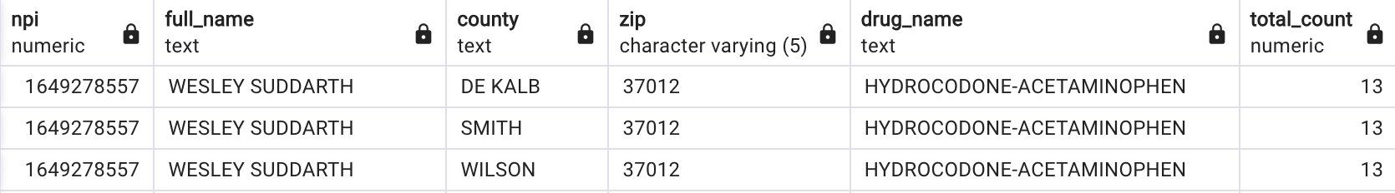
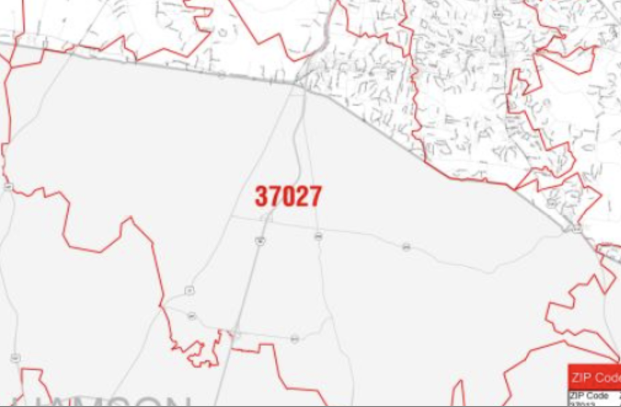
Intro - The Problem with this Dataset
Davidson
Why is this happening?
Williamson

Slide 3
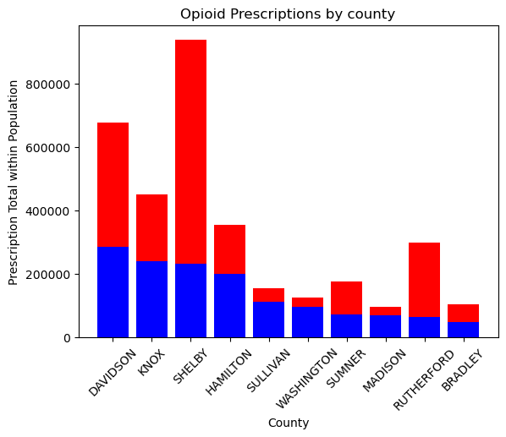
Trends in Opioid Prescriptions by County
Davidson, Shelby, Knox, and Hamilton counties are disproportionately higher than the rest.
These 4 counties are associated with the 4 largest cities of TN (Nashville, Memphis, Knoxville, and Chattanooga).

Slide 4
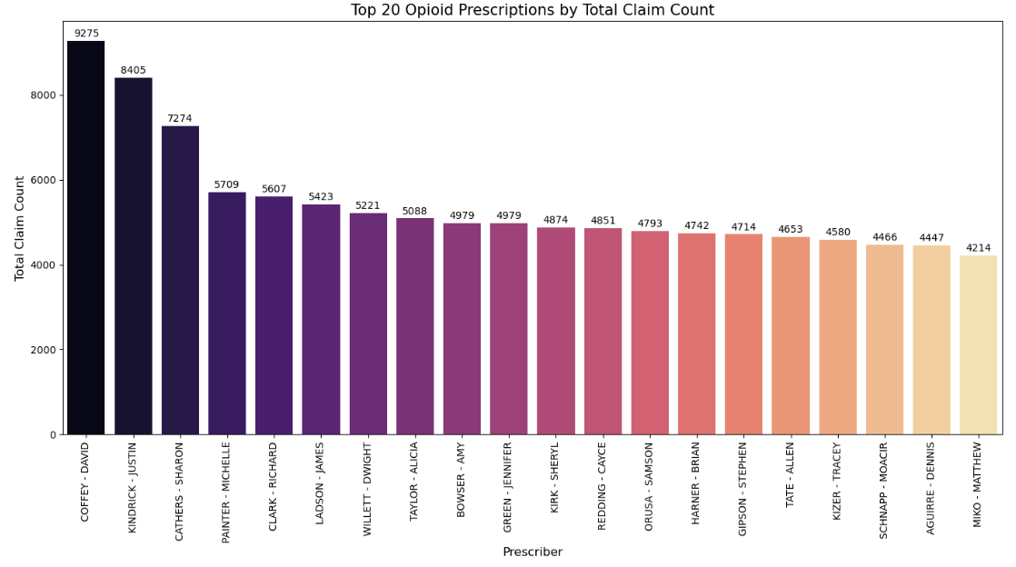
Top Opioid Prescribers in TN

Slide 5
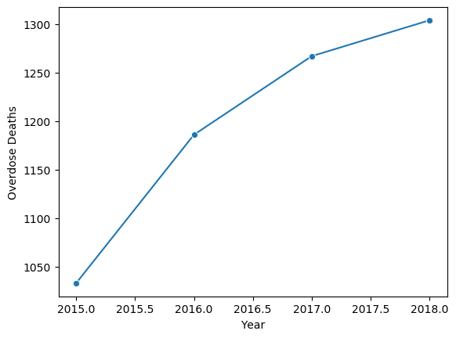
Overdose-Related Deaths by Year
Note: Deaths in the overdose_deaths table are all believed to be opioid-related. This is not officially confirmed within the data dictionary, however. (CDC indicated a 2018 TN opioid overdose count of 1,306, vs. this dataset’s count of 1,304)
Sharpest increase occurred from 2015-2016, then progressively leveling out going into 2018.

Slide 6
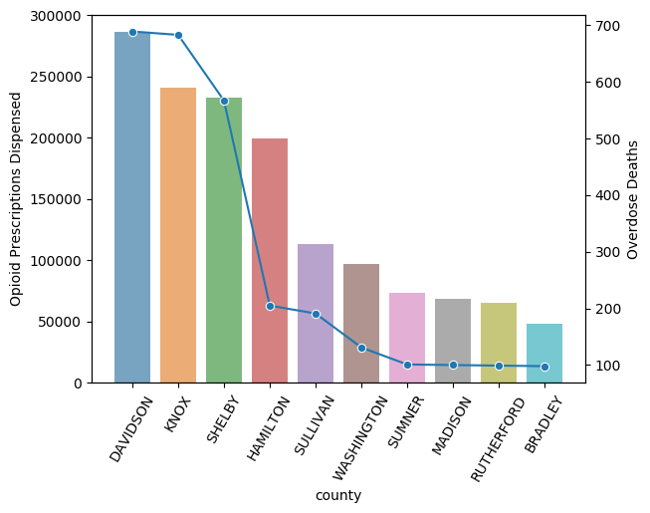
The relationship between rates of opioid prescriptions and overdose deaths
The overdose death rate (represented by the blue line) appears to have a direct correlation with prescription counts, with one decreasing along with the other.
Hamilton county appears to be an outlier here, showing a low death count despite being the fourth-highest in claim counts.

Slide 7
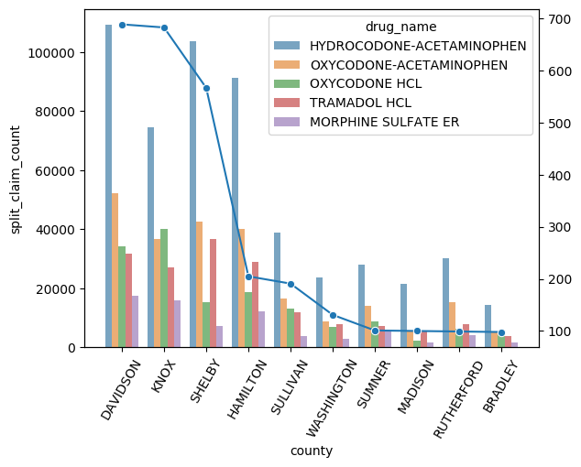
The relationship between types of opioid prescriptions and overdose deaths
The overdose death rate appears to conform most closely with the total prescriptions for Hydrocodone-Acetaminophen, which happens to be the most-prescribed opioid in all of the top 10 TN counties.

Slide 8
Questions?

